Slide 1
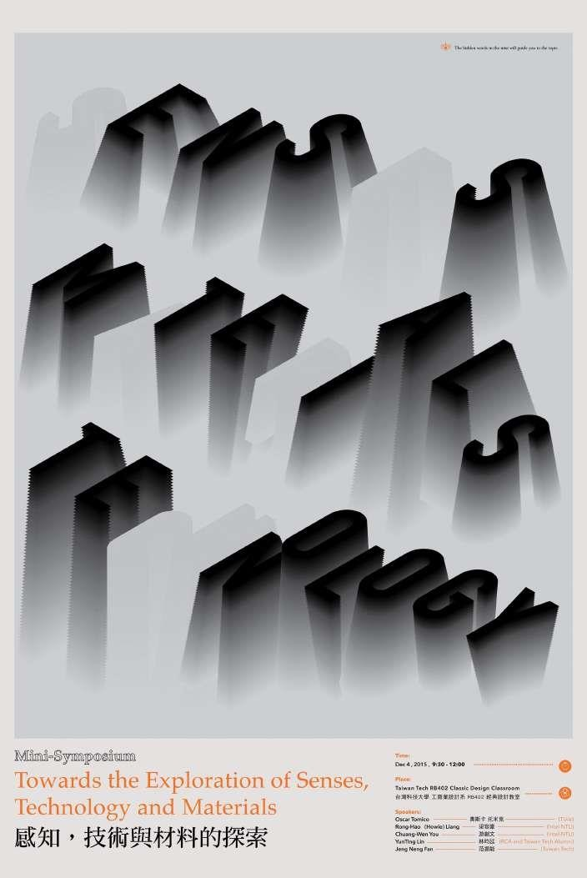
Concealing Confidential Messages: Python's Image Steganography
Steganography is the act of concealing a message in plain sight. In today's world where data privacy is crucial, steganography has become a powerful tool for concealing confidential information from prying eyes. In this presentation, we wi l explore how Python can be leveraged for image steganography and how it can be useful for secure communication.

Slide 2

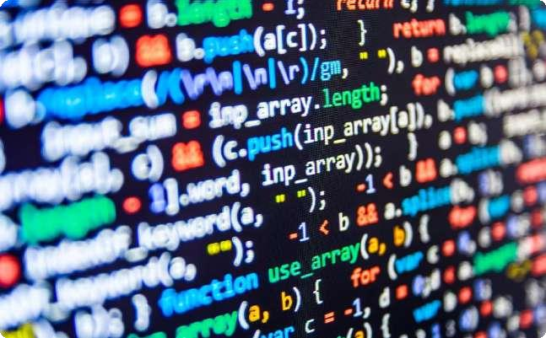
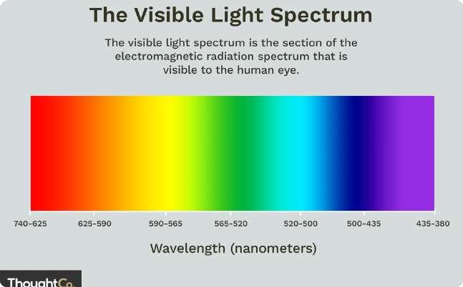
Overview of Steganography Techniques
Whatis Steganography?
Steganography is the practice of hiding a message within another message, in a way that does not attract attention to the hidden message. Digital data can beconcealed within audio, video or image files using various steganography techniques.
Python's Role in Image Steganography
Python provides a simple and versatile way of implementing image steganography. Using Python, we can read, modify, and save image files, making it an ideal language for this task.
Overviewof Image Steganography
One common method of image steganography involves hiding data in the color spectrum of an image. Different colors represent different values and by modifying the color values, we can embed information in an image without it being noticed visually.

Slide 3

Common Image Steganography Methods
LSBSubstitution
This method involves hiding bits of data in the least significant bits of an image's color values, which has no noticeable effect on the quality
Spread Spectrum
A cryptographic technique that spreads information across multiple frequencies this method provides great protection against attacks like scrambling the image sequence, cropping, and disguising the message.
Masking and Filtering
This approach involves adding noise to images. Filtering techniques are then used to extract the noise and any data embedded within it.

Slide 4
Python Libraries for Image Steganography
1
Pillow
Pillow is a Python Imaging Library that provides the “backbone” for many other Python image processing libraries. It includes several features to support image processing including basic image editing tools, color adjustments, and a range of filters.
Stegano
A pure Python Steganography module, this library can be used to encrypt and decrypt message hiding theminside images hidden, evacuating no trace that wil act as a covert channelto transmit data securely between two endpoints.
2

Slide 5
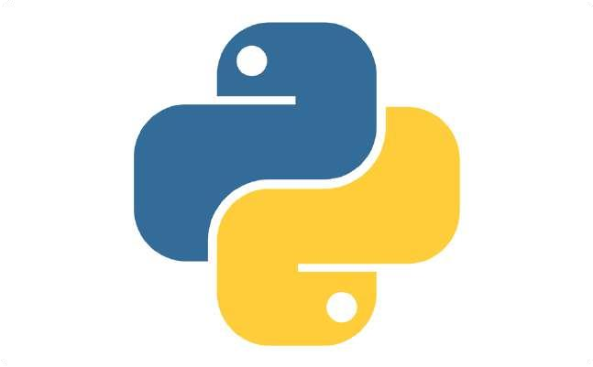

Implementation of Image Steganography in Python
Encoding Messages into Images with Python
Step-by-step instructions on how to encode a message into an image file using Python along with the LSB technique.
Decoding Messages fromImages with Python
Detailed instructions on how to decode secret information from images with Python. A simple Python script that extracts the hidden message is used in the demonstration

Slide 6

Conclusion
1
Steganography forSafe Communication
This presentation explained the importance of steganography to ensure secure communication. Implanting a messageusing steganography techniqueprovides an extra layerof security for confidential messages.
2
Python-made Steganography
The role and importance of Python in image Steganographyhas also been highlighted in this presentation. We have demonstrated how Python can be used to implement steganography techniques and outlined key libraries available to support this process.

